Slide 1

Introduction to Machine Learning and Toolkit
Dina Machuve, PhD
July, 2019

Slide 2
Acknowledgment
Intel Academic Programme
Late Dr. Yaw Nkansah-Gyekye

Slide 3
Artificial Intelligence
Artificial Intelligence is the broader concept of machines being able to carry out tasks in a way that we will consider “smart”.
In the past few years, AI has moved from research labs into our everyday lives.
It is being used in medical devices, smart-home systems, and video games—to say nothing of robots and autonomous cars.
AI paradox: taking over our jobs.

Slide 4
Introducing Machine Intelligence
Machine learning is a particular approach to AI just as Deep Learning is a kind of ML.
Machine learning is the major success factor in the ongoing digital transformation across industries.
Startups and behemoths alike announce new products that will learn to perform tasks that previously only humans could do, and perform those tasks better, faster, and more intelligently.

Slide 5
A Few Quotes on ML
“A breakthrough in machine learning would be worth ten Microsofts” (Bill Gates, Chairman, Microsoft)
“Machine learning is the next Internet” (Tony Tether, Director, DARPA)
Machine learning is the hot new thing” (John Hennessy, President, Stanford University)
“Web rankings today are mostly a matter of machine learning” (Prabhakar Raghavan, Dir. Research, Yahoo)
“Machine learning is going to result in a real revolution” (Greg Papadopoulos, Former CTO, Sun)

Slide 6
What Is Machine Learning? – 2
Automating automation
Getting computers to program themselves
Writing software is the bottleneck
Let the data do the work instead!

Slide 7
Traditional Programming
Machine Learning
Data
Computer
Output
Program
Data
Computer
Program
Output

Slide 8

Magic?
No, more like gardening
Seeds = Algorithms
Nutrients = Data
Gardener = You
Plants = Programs

Slide 9
Applications of Machine Learning
Propelled by massively parallel computer systems and huge datasets, machine learning has become particularly important for solving problems in areas such as:
Image processing and computer vision, for face recognition, motion detection, and object detection
Natural language processing
Computational biology, for tumor detection, drug discovery, and DNA sequencing
Energy production, for price and load forecasting

Slide 10
Applications of Machine Learning – 2
Computational finance, for credit scoring and algorithmic trading
Automotive, aerospace, and manufacturing, for predictive maintenance
Robotics
Web search
Social networking

Slide 11
ML in a Nutshell
Tens of thousands of machine learning algorithms
Hundreds of new ML algorithms every year
Every machine learning algorithm has three main components:
Representation
Evaluation
Optimization
REO in short self created

Slide 12
Representation
Decision trees
Sets of rules / Logic programs
Instances
Graphical models (Bayes/Markov nets)
Neural networks
Support vector machines
Model ensembles Etc.

Slide 13
Evaluation
Accuracy
Precision and recall
Squared error
Likelihood
Posterior probability
Cost / Utility
Margin
Entropy
K-L divergence Etc.

Slide 14
Optimization
Combinatorial optimization
e.g.: Greedy search
Convex optimization
e.g.: Gradient descent
e.g.: Stochastic gradient descent
Constrained optimization
e.g.: Linear programming
e.g.: Nonlinear programming

Slide 15
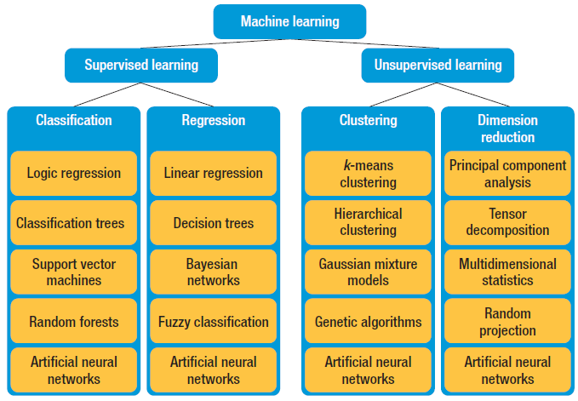

Slide 16
ML in Practice
Understanding domain, prior knowledge, and goals
Data integration, selection, cleaning, pre-processing, etc.
Learning models
Interpreting results
Consolidating and deploying discovered knowledge
Loop

Slide 17
When Should You Use Machine Learning?
Consider using machine learning when
you have a complex task or problem involving a large amount of data and lots of variables,
but no existing formula or equation.

Slide 18
When Should You Use Machine Learning? – 2
For example, machine learning is a good option if you need to handle situations like these:
Hand-written rules and equations are too complex—as in face recognition and speech recognition.
The rules of a task are constantly changing—as in fraud detection from transaction records.

Slide 19
When Should You Use Machine Learning? – 3
The nature of the data keeps changing, and the program needs to adapt—as in automated trading, energy demand forecasting, and predicting shopping trends.

Slide 20
Toolset: Distribution for Python
Jupyter notebooks: interactive coding and visualization of output
NumPy, SciPy, Pandas: numerical computation
Matplotlib, Seaborn: data visualization
Scikit-learn: machine learning
Notes:
Once the installation is complete, we will mostly use these tools:
Jupyter notebooks provide a great workspace, in-browser coding, where we can define variables, work with them at our pace, and analyze them as we go. We will look at them shortly.
Numpy and Scipy are essential libraries when working with numerical data. Other libraries are built on top of these two.
Matplotlib and Seaborn are used for visualizing data and results. Together with Jupyter notebooks, they create beautiful plots
And last but not least, sklearn for machine learning. Very popular and powerful ML library

Slide 21
Introduction to Jupyter Notebook
Polyglot analysis environment—blends multiple languages
Jupyter is an anagram of: Julia, Python, and R
Supports multiple content types: code, narrative text, images, movies, etc.
Source: http://jupyter.org/
Notes:
Let’s start by looking at Jupyter notebooks.
It gives us an in-browser environment, interactive coding experience. And we can use multiple languages.

Slide 22
Introduction to Jupyter Notebook
Polyglot analysis environment—blends multiple languages
Jupyter is an anagram of: Julia, Python, and R
Supports multiple content types: code, narrative text, images, movies, etc.
Source: http://jupyter.org/
Notes:
Julia Python and R. We’re going to stick to Python.

Slide 23
Introduction to Jupyter Notebook
Polyglot analysis environment—blends multiple languages
Jupyter is an anagram of: Julia, Python, and R
Supports multiple content types: code, narrative text, images, movies, etc.
Source: http://jupyter.org/
Notes:
You can write code, add beautiful markdown text, images, insert youtube videos etc.

Slide 24
Introduction to Jupyter Notebook
HTML & Markdown
LaTeX (equations)
Code
Source: http://jupyter.org/
Notes:
Its structure is, essentially, a sequence of “cells”
A cell contains either HTML/MD
Or Latex
Or Actual Code

Slide 25
Introduction to Jupyter Notebook
HTML & Markdown
LaTeX (equations)
Code
Source: http://jupyter.org/
Notes:
Here in this picture, it starts with a Markdown cell.
It has a header and some text explaining what we are about to do.
Kind of like commenting but much prettier.

Slide 26
Introduction to Jupyter Notebook
HTML & Markdown
LaTeX (equations)
Code
Source: http://jupyter.org/
Notes:
It is then followed by some Latex equations.

Slide 27
Introduction to Jupyter Notebook
HTML & Markdown
LaTeX (equations)
Code
Source: http://jupyter.org/
Notes:
And finally some code, which can define variables, modify them, basically do everything what code can do.
Here, it is creating an interactive plot of a Lorenz System, in the notebook.
All of this combined creates the perfect tool that connects programming with storytelling.
This makes Jupyter notebooks the best friend of a data scientist.
The work is saved to a .ipynb file which can be converted to html, pdf etc. to create beautiful websites / presentations.

Slide 28
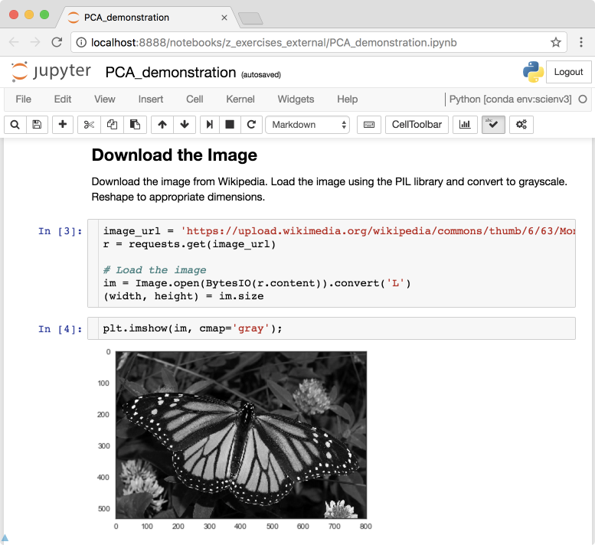
Introduction to Jupyter Notebook
Code is divided into cells to control execution
Enables interactive development
Ideal for exploratory analysis and model building
Notes:
Let’s look at how the code flows throughout a notebook:
It is divided into cells. This enables the user to
stop and look at what happened
what is the state of the variable
Write new code in the next cell
etc
This is the interactive development that is great for exploring the data and model building.

Slide 29
Introduction to Jupyter Notebook
Code is divided into cells to control execution
Enables interactive development
Ideal for exploratory analysis and model building
Notes:
One drawback of this could be that the user can hurt themselves if they run cells in the wrong order.
The Kernel runs in the order that cells are executed, not necessarily in the order they are in the browser.

Slide 30
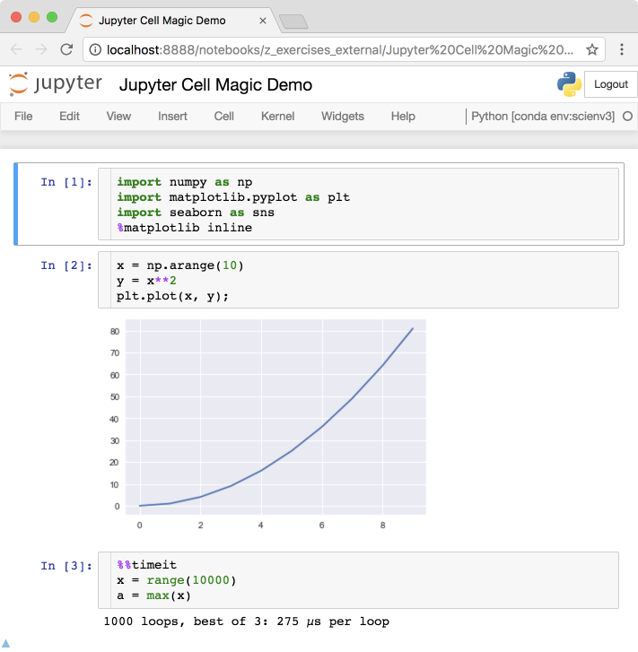
Jupyter Cell Magics
%matplotlib inline: display plots inline in Jupyter notebook
%%timeit: time how long a cell takes to execute
%run filename.ipynb: execute code from another notebook or python file
Notes:
There are so called “magic” commands that jupyter understands which are very useful.

Slide 31
Jupyter Cell Magics
%matplotlib inline: display plots inline in Jupyter notebook
%%timeit: time how long a cell takes to execute
%run filename.ipynb: execute code from another notebook or python file
Notes:
Arguably the most popular is %matplotlib inline
Which puts the plots produced by code in the notebook (as opposed to in a new window)
The figure is produced and saved in the notebook, and it’s there the next time the notebook is loaded. (same for the code)

Slide 32
Jupyter Cell Magics
%matplotlib inline: display plots inline in Jupyter notebook
%%timeit: time how long a cell takes to execute
%run filename.ipynb: execute code from another notebook or python file
Notes:
This figure would have been shown as a new window otherwise.

Slide 33
Jupyter Cell Magics
%matplotlib inline: display plots inline in Jupyter notebook
%%timeit: time how long a cell takes to execute
Notes:
Another super useful magic is %%timeit.
%%timeit times the execution for the whole cell
%timeit will time the execution for that line only! ( e.g. %timeit max(range(10**6)) )

Slide 34
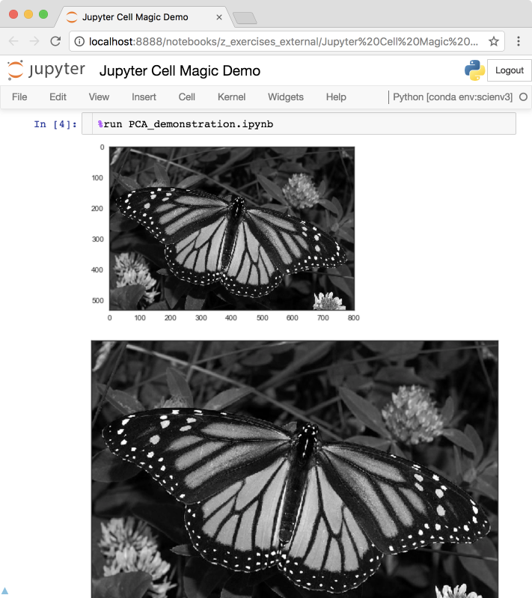
Jupyter Cell Magics
%matplotlib inline: display plots inline in Jupyter notebook
%%timeit: time how long a cell takes to execute
%run filename.ipynb: execute code from another notebook or python file
Notes:
%run will run code from another notebook or python file, and it will import its variables to this one.

Slide 35
Jupyter Cell Magics
%matplotlib inline: display plots inline in Jupyter notebook
%%timeit: time how long a cell takes to execute
%run filename.ipynb: execute code from another notebook or python file
%load filename.py: copy contents of the file and paste into the cell
Notes:
%load will copy the contents from a python file and paste it into the cell.
It will not run it by default though.
With %run, you won’t see the file, just variables.

Slide 36
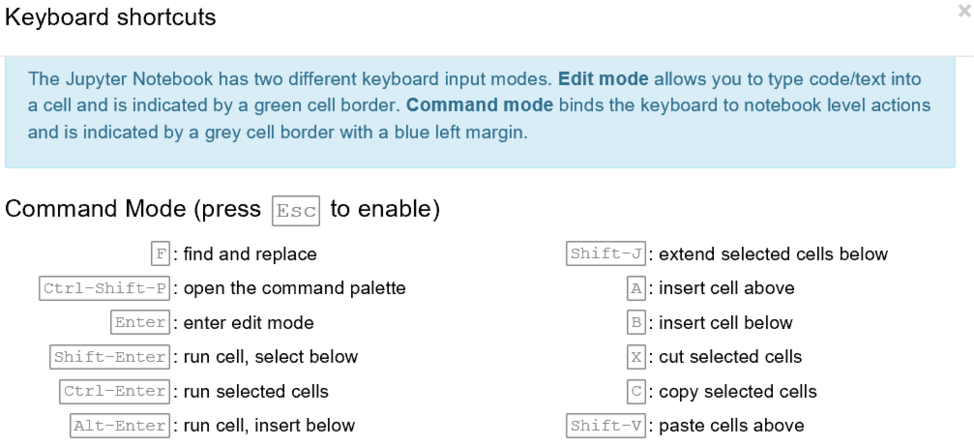
Jupyter Keyboard Shortcuts
Keyboard shortcuts can be viewed from Help → Keyboard Shortcuts
Notes:
Notebooks offer a lot of flexibility when coding.
Jumping outside “edit mode” (ex: by clicking outside a cell), we can create a new cell, delete cells, change code cell to markup etc with just shortcuts.

Slide 37
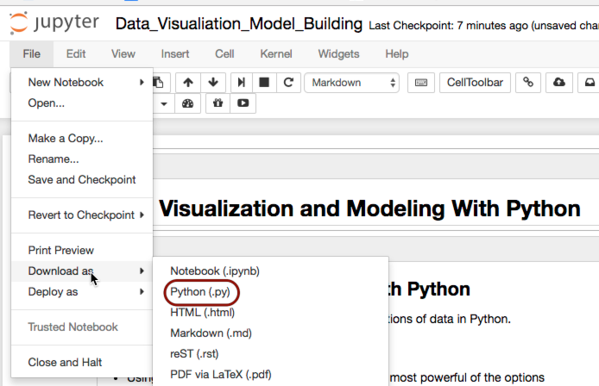
Making Jupyter Notebooks Reusable
To extract Python code from a Jupyter notebook:
Convert from Command Line
>>> jupyter nbconvert --to python notebook.ipynb
Export from within notebook
Notes:
Notebooks can be converted to .py files, pdf, html etc from the command line

Slide 38
Making Jupyter Notebooks Reusable
To extract Python code from a Jupyter notebook:
Convert from Command Line
>>> jupyter nbconvert --to python notebook.ipynb
Export from Notebook
Notes:
Or directly within the notebook using the menu.
A lot of other functionality to, feel free to explore it.

Slide 39
Introduction to Pandas
Library for computation with tabular data
Mixed types of data allowed in a single table
Columns and rows of data can be named
Advanced data aggregation and statistical functions
Source: http://pandas.pydata.org/
Notes:
Let’s talk about pandas. Pandas is a data manipulation library by Wes McKinney.
It is extremely useful, full of functionality.
Makes working with data very easy.
Easy access to statistical functions, data aggregation, visualization etc.

Slide 40
Introduction to Pandas
Basic data structures
Type
Pandas Name
Vector
(1 Dimension)
Series
Array
(2 Dimensions)
DataFrame
Notes:
Let’s see how it works.
Pandas stands for panel data sets.
It refers to data in tabular form, with rows and columns
The most basic data structure is the “series”. It’s 1 dimensional, it’s the building block for data in tabular form.

Slide 41
Introduction to Pandas
Basic data structures
Type
Pandas Name
Vector
(1 Dimension)
Series
Array
(2 Dimensions)
DataFrame
Notes:
And “data in tabular form” has a name: It’s called pd.DataFrame
Dataframe consists of rows and columns. 2 dimensions.
If you pop a column from a dataframe, it is a series.
If you pop a row from a dataframe, it is a series too.

Slide 42
Pandas Series Creation and Indexing
Use data from step tracking application to create a Pandas Series
Code
Output
import pandas as pd
step_data = [3620, 7891, 9761,
3907, 4338, 5373]
step_counts = pd.Series(step_data, name='steps')
print(step_counts)
>>> 0 3620
1 7891
2 9761
3 3907
4 4338
5 5373
Name: steps, dtype: int64
Notes:
Import pandas as pd is the standard syntax for importing pandas.
Here we’re creating an array.
And we’re then applying pd.Series constructor to it.
Now step_counts is a pandas series.

Slide 43
Pandas Series Creation and Indexing
Use data from step tracking application to create a Pandas Series
Code
Output
import pandas as pd
step_data = [3620, 7891, 9761,
3907, 4338, 5373]
step_counts = pd.Series(step_data, name='steps')
print(step_counts)
>>> 0 3620
1 7891
2 9761
3 3907
4 4338
5 5373
Name: steps, dtype: int64
Notes:
And this is the output. It indexed the data we gave it.
Index is 0-5
And it gave this new object a name, “Steps”.

Slide 44
Pandas Series Creation and Indexing
Add a date range to the Series
Code
Output
step_counts.index = pd.date_range('20150329', periods=6)
print(step_counts)
>>> 2015-03-29 3620
2015-03-30 7891
2015-03-31 9761
2015-04-01 3907
2015-04-02 4338
2015-04-03 5373
Freq: D, Name: steps, dtype: int64
Notes:
That was fairly standard..
But maybe those step counts are tied to some days, as opposed to 0 to 5.
So we can change the series index, and put same dates in there.
Pd.date_range is a pandas routine that creates dates. Here we’re creating 6 successive dates starting from this string’s date.

Slide 45
Pandas Series Creation and Indexing
Add a date range to the Series
Code
Output
step_counts.index = pd.date_range('20150329', periods=6)
print(step_counts)
>>> 2015-03-29 3620
2015-03-30 7891
2015-03-31 9761
2015-04-01 3907
2015-04-02 4338
2015-04-03 5373
Freq: D, Name: steps, dtype: int64
Notes:
And our series is now indexed differently.
Notice the values of the series stayed the same. Index is reassigned to dates.

Slide 46
Pandas Series Creation and Indexing
Select data by the index values
Code
Output
# Just like a dictionary
print(step_counts['2015-04-01'])
# Or by index position--like an array
print(step_counts[3])
# Select all of April
print(step_counts['2015-04'])
>>> 3907
>>> 3907
>>> 2015-04-01 3907
2015-04-02 4338
2015-04-03 5373
Freq: D, Name: steps, dtype: int64
Notes:
Pandas Series is very similar to python dictionaries. We can retrieve the values with the same syntax.

Slide 47
Pandas Series Creation and Indexing
Select data by the index values
Code
Output
# Just like a dictionary
print(step_counts['2015-04-01'])
# Or by index position--like an array
print(step_counts[3])
# Select all of April
print(step_counts['2015-04'])
>>> 3907
>>> 3907
>>> 2015-04-01 3907
2015-04-02 4338
2015-04-03 5373
Freq: D, Name: steps, dtype: int64
Notes:
Here it is.

Slide 48
Pandas Series Creation and Indexing
Select data by the index values
Code
Output
# Just like a dictionary
print(step_counts['2015-04-01'])
# Or by index position--like an array
print(step_counts[3])
# Select all of April
print(step_counts['2015-04'])
>>> 3907
>>> 3907
>>> 2015-04-01 3907
2015-04-02 4338
2015-04-03 5373
Freq: D, Name: steps, dtype: int64
Notes:
But as opposed to dictionaries, we can also retrieeve them by index position.

Slide 49
Pandas Series Creation and Indexing
Select data by the index values
Code
Output
# Just like a dictionary
print(step_counts['2015-04-01'])
# Or by index position--like an array
print(step_counts[3])
# Select all of April
print(step_counts['2015-04'])
>>> 3907
>>> 3907
>>> 2015-04-01 3907
2015-04-02 4338
2015-04-03 5373
Freq: D, Name: steps, dtype: int64
Notes:
This is not possible in dictionaries

Slide 50
Pandas Series Creation and Indexing
Select data by the index values
Code
Output
# Just like a dictionary
print(step_counts['2015-04-01'])
# Or by index position--like an array
print(step_counts[3])
# Select all of April
print(step_counts['2015-04'])
>>> 3907
>>> 3907
>>> 2015-04-01 3907
2015-04-02 4338
2015-04-03 5373
Freq: D, Name: steps, dtype: int64
Notes:
We can slice effectively too. This command gets all the april records.

Slide 51
Pandas Series Creation and Indexing
Select data by the index values
Code
Output
# Just like a dictionary
print(step_counts['2015-04-01'])
# Or by index position--like an array
print(step_counts[3])
# Select all of April
print(step_counts['2015-04'])
>>> 3907
>>> 3907
>>> 2015-04-01 3907
2015-04-02 4338
2015-04-03 5373
Freq: D, Name: steps, dtype: int64
Notes:
XXX

Slide 52
Pandas Data Types and Imputation
Data types can be viewed and converted
Code
Output
# View the data type
print(step_counts.dtypes)
# Convert to a float
step_counts = step_counts.astype(np.float)
# View the data type
print(step_counts.dtypes)
>>> int64
>>> float64
Notes:
A series can store integers, floats, strings, etc.
This is how you can view what kind of data it stores.

Slide 53
Pandas Data Types and Imputation
Data types can be viewed and converted
Code
Output
# View the data type
print(step_counts.dtypes)
# Convert to a float
step_counts = step_counts.astype(np.float)
# View the data type
print(step_counts.dtypes)
>>> int64
>>> float64
Notes:
It’s an integer.

Slide 54
Pandas Data Types and Imputation
Data types can be viewed and converted
Code
Output
# View the data type
print(step_counts.dtypes)
# Convert to a float
step_counts = step_counts.astype(np.float)
# View the data type
print(step_counts.dtypes)
>>> int64
>>> float64
Notes:
.astype is a series method which can convert the datatype.
Here, let’s see the same series converted to float.

Slide 55
Pandas Data Types and Imputation
Data types can be viewed and converted
Code
Output
# View the data type
print(step_counts.dtypes)
# Convert to a float
step_counts = step_counts.astype(np.float)
# View the data type
print(step_counts.dtypes)
>>> int64
>>> float64
Notes:
Yep, it’s now float.

Slide 56
Pandas Data Types and Imputation
Invalid data points can be easily filled with values
Code
Output
# Create invalid data
step_counts[1:3] = np.NaN
# Now fill it in with zeros
step_counts = step_counts.fillna(0.)
# equivalently,
# step_counts.fillna(0., inplace=True)
print(step_counts[1:3])
>>> 2015-03-30 0.0
2015-03-31 0.0
Freq: D, Name: steps, dtype: float64
Notes:
Missing data is a fact of life, and pandas offer various ways to impute it.
Here, we’re assigning np.NaN to some of the entries. It is numpy’s way of saying “data is missing”.
Series.fillna is a function to fill those missing values with the given value.

Slide 57
Pandas Data Types and Imputation
Invalid data points can be easily filled with values
Code
Output
# Create invalid data
step_counts[1:3] = np.NaN
# Now fill it in with zeros
step_counts = step_counts.fillna(0.)
# equivalently,
# step_counts.fillna(0., inplace=True)
print(step_counts[1:3])
>>> 2015-03-30 0.0
2015-03-31 0.0
Freq: D, Name: steps, dtype: float64
Notes:
Here, we see the rows are filled. It returns a new Series as opposed to filling it in place. For that, you need to pass it as an argument as in:
Step_counts.fillna(0, inplace=True)

Slide 58
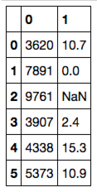
Pandas DataFrame Creation and Methods
DataFrames can be created from lists, dictionaries, and Pandas Series
Code
Output
# Cycling distance
cycling_data = [10.7, 0, None, 2.4, 15.3, 10.9, 0, None]
# Create a tuple of data
joined_data = list(zip(step_data, cycling_data))
# The dataframe
activity_df = pd.DataFrame(joined_data)
print(activity_df)
>>>
Notes:
Now that we are familiar with series, let’s talk about dataframes
A dataframe is basically a collection of series.
Since series are 1 dimensional, Dataframe is two dimensional.
If you visualize a series as one column, dataframe becomes visually several columns attached side by side.
So it is a table of data.
Here, we create a new list of numbers, 2 missing values
No joined data is a list, whose elements are tuples of size 2!

Slide 59
Pandas DataFrame Creation and Methods
DataFrames can be created from lists, dictionaries, and Pandas Series
Code
Output
# Cycling distance
cycling_data = [10.7, 0, None, 2.4, 15.3, 10.9, 0, None]
# Create a tuple of data
joined_data = list(zip(step_data, cycling_data))
# The dataframe
activity_df = pd.DataFrame(joined_data)
print(activity_df)
>>>
Notes:
And calling pd.DataFrame constructor on that, we get this nice output:
This is a dataframe. Index is 0-5, (since we arent building on the series we created, we are starting from scratch)
Column 0 is the step count
Col 1 is this new data, truncated to the shortest list (property of zip, not dataframe.)

Slide 60
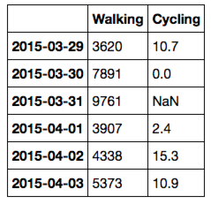
Pandas DataFrame Creation and Methods
Labeled columns and an index can be added
Code
Output
# Add column names to dataframe
activity_df = pd.DataFrame(
joined_data,
index=pd.date_range('20150329', periods=6),
columns=['Walking','Cycling'])
print(activity_df)
>>>
Notes:
Let’s make this dataframe a bit more self-explanatory
Data is the same, `joined_data`
Index is going to be the same index we created for the series, namely the days.
Columns are ‘walking’ and ‘cycling’ as opposed to 0 and 1.

Slide 61
Pandas DataFrame Creation and Methods
Labeled columns and an index can be added
Code
Output
# Add column names to dataframe
activity_df = pd.DataFrame(joined_data,
index=pd.date_range('20150329',
periods=6),
columns=['Walking','Cycling'])
print(activity_df)
>>>
Notes:
This DF is much more descriptive.

Slide 62
Indexing DataFrame Rows
DataFrame rows can be indexed by row using the 'loc' and 'iloc' methods
Code
Output
# Select row of data by index name
print(activity_df.loc['2015-04-01'])
>>> Walking 3907.0
Cycling 2.4
Name: 2015-04-01,
dtype: float64
Notes:
Now we have a 2dimensional data structure, so getting to elements is a bit different compared to series, which was very dictionary-like.
If we want to get a full row, we use dataframe’s .loc method
We provide the index value to .loc

Slide 63
Indexing DataFrame Rows
DataFrame rows can be indexed by row using the 'loc' and 'iloc' methods
Code
Output
# Select row of data by index name
print(activity_df.loc['2015-04-01'])
>>> Walking 3907.0
Cycling 2.4
Name: 2015-04-01,
dtype: float64
Notes:
And what we get in return is a pd.Series.
Index of that series is the columns of the dataframe, namely ‘walking’ and ‘cycling’.

Slide 64
Indexing DataFrame Rows
DataFrame rows can be indexed by row using the 'loc' and 'iloc' methods
Code
Output
# Select row of data by integer position
print(activity_df.iloc[-3])
>>> Walking 3907.0
Cycling 2.4
Name: 2015-04-01,
dtype: float64
Notes:
If we want to get rows by position as opposed to the index value, we use .iloc (not .loc)
And here we also have the niceties of python lists, providing negative numbers as the position

Slide 65
Indexing DataFrame Rows
DataFrame rows can be indexed by row using the 'loc' and 'iloc' methods
Code
Output
# Select row of data by integer position
print(activity_df.iloc[-3])
>>> Walking 3907.0
Cycling 2.4
Name: 2015-04-01,
dtype: float64
Notes:
We get the same answer.

Slide 66
Indexing DataFrame Columns
DataFrame columns can be indexed by name
Code
Output
# Name of column
print(activity_df['Walking'])
>>> 2015-03-29 3620
2015-03-30 7891
2015-03-31 9761
2015-04-01 3907
2015-04-02 4338
2015-04-03 5373
Freq: D, Name: Walking,
dtype: int64
Notes:
If we tried to get something as in the dictionary/pd.Series case, pandas looks at the columns.
This will get the walking column.
If you had a row indexed as ‘walking’, this would get you the walking column.
If you didn’t have a column, but only an index, this would error.
Conclusion: use .loc or .iloc if you want to get rows!

Slide 67
Indexing DataFrame Columns
DataFrame columns can be indexed by name
Code
Output
# Name of column
print(activity_df['Walking'])
>>> 2015-03-29 3620
2015-03-30 7891
2015-03-31 9761
2015-04-01 3907
2015-04-02 4338
2015-04-03 5373
Freq: D, Name: Walking,
dtype: int64
Notes:
The output of this is again, a Series.
This time, index of the Series is the same as the index of the DataFrame.

Slide 68
Indexing DataFrame Columns
DataFrame columns can also be indexed as properties
Code
Output
# Object-oriented approach
print(activity_df.Walking)
>>> 2015-03-29 3620
2015-03-30 7891
2015-03-31 9761
2015-04-01 3907
2015-04-02 4338
2015-04-03 5373
Freq: D, Name: Walking,
dtype: int64
Notes:
column names can be any string, but if it happens that there is no spaces, +- signs etc., they can also be accessed as attributes of the dataframe.
Just another reason to name your DF columns well.

Slide 69
Indexing DataFrame Columns
DataFrame columns can also be indexed as properties
Code
Output
# Object-oriented approach
print(activity_df.Walking)
>>> 2015-03-29 3620
2015-03-30 7891
2015-03-31 9761
2015-04-01 3907
2015-04-02 4338
2015-04-03 5373
Freq: D, Name: Walking,
dtype: int64
Notes:
Result is the same.

Slide 70
Indexing DataFrame Columns
DataFrame columns can be indexed by integer
Code
Output
# First column
print(activity_df.iloc[:,0])
>>> 2015-03-29 3620
2015-03-30 7891
2015-03-31 9761
2015-04-01 3907
2015-04-02 4338
2015-04-03 5373
Freq: D, Name: Walking,
dtype: int64
Notes:
Columns can be accessed by position with this trick.
Here, we’re getting all rows by “:”, and the 0th column.

Slide 71
Indexing DataFrame Columns
DataFrame columns can be indexed by integer
Code
Output
# First column
print(activity_df.iloc[:,0])
>>> 2015-03-29 3620
2015-03-30 7891
2015-03-31 9761
2015-04-01 3907
2015-04-02 4338
2015-04-03 5373
Freq: D, Name: Walking,
dtype: int64
Notes:
XXX

Slide 72
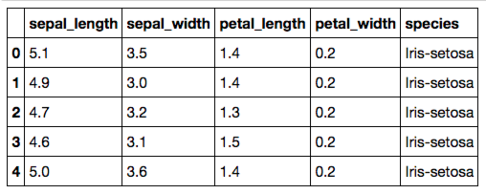
Reading Data with Pandas
CSV and other common filetypes can be read with a single command
Code
Output
# The location of the data file
filepath = 'data/Iris_Data/Iris_Data.csv'
# Import the data
data = pd.read_csv(filepath)
# Print a few rows
print(data.iloc[:5])
>>>
Notes:
Let’s look at how we can read, load data (I/O)
Let’s say you have a csv file in disk.
Pd.read_csv will read it and construct a DataFrame with the contents.

Slide 73
Reading Data with Pandas
CSV and other common filetypes can be read with a single command
Code
Output
# The location of the data file
filepath = 'data/Iris_Data/Iris_Data.csv'
# Import the data
data = pd.read_csv(filepath)
# Print a few rows
print(data.iloc[:5])
>>>
Notes:
Here we’re printing the first 5 rows.
Incidentally, this dataset has 5 columns as well.
First 4 columns seem to be numeric. The last one is categorical.
The data types are automatically interpreted.
It’s also important to note read_csv takes a lot of keyword arguments, specifying how the data is going to be read.
E.g. no header,
skip some rows,
don’t read all at once but iterate,
delimiter is tab not comma etc etc.

Slide 74
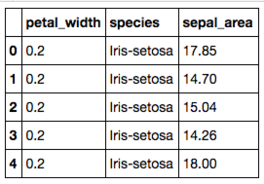
Assigning New Data to a DataFrame
Data can be (re-)assigned to a DataFrame column
Code
Output
# Create a new column that is a product
# of both measurements
data['sepal_area'] = data.sepal_length * data.sepal_width
# Print a few rows and columns
print(data.iloc[:5, -3:])
>>>
Notes:
Now we promised that data manipulation was very easy using pandas. So let’s see some examples.
Let’s create a new column out of the ones we have:
Since we have length and width, we can create area as in here.
The multiplication is a multiplication of series. Pandas understands this and multiplies elements one by one
The result is a series too. It is then assigned to the dataframe, and the column name is “sepal_area”

Slide 75
Assigning New Data to a DataFrame
Data can be (re-)assigned to a DataFrame column
Code
Output
# Create a new column that is a product
# of both measurements
data['sepal_area'] = data.sepal_length * data.sepal_width
# Print a few rows and columns
print(data.iloc[:5, -3:])
>>>
Notes:
As you see, it’s added to the end here. We’re printing the last 3 columns.

Slide 76
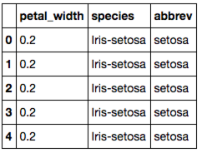
Applying a Function to a DataFrame Column
Functions can be applied to columns or rows of a DataFrame or Series
Code
Output
# The lambda function applies what
# follows it to each row of data
data['abbrev'] = (data
.species
.apply(lambda x: x.replace('Iris-','')))
# Note that there are other ways to
# accomplish the above
print(data.iloc[:5, -3:])
>>>
Notes:
This was a very common operation, just multiplication.
There can be other custom operations that we want to perform.
If you noticed, the values in the species column all start with “Iris-”. Let’s get rid of that.
Data.species gets the series we want to work on
.apply applies a function to every value (not the index) of the series and returns a new series.
And lambda determines the function. Lambda is just python’s way of defining functions quickly.
If you have a more involved function f, u can use it as `.apply(f)`

Slide 77
Applying a Function to a DataFrame Column
Functions can be applied to columns or rows of a DataFrame or Series
Code
Output
# The lambda function applies what
# follows it to each row of data
data['abbrev'] = (data
.species
.apply(lambda x: x.replace('Iris-','')))
# Note that there are other ways to
# accomplish the above
print(data.iloc[:5, -3:])
>>>
Notes:
So, this new column we created, ‘abbrev’, is appended to the dataframe.

Slide 78
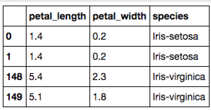
Concatenating Two DataFrames
Two DataFrames can be concatenated along either dimension
Code
Output
# Concatenate the first two and
# last two rows
small_data = pd.concat([data.iloc[:2],
data.iloc[-2:]])
print(small_data.iloc[:,-3:])
# See the 'join' method for
# SQL style joining of dataframes
>>>
Notes:
One of the most essential operations is bringing two related datasets together.
Here’s an example on how to concatenate two DFs.
This adds rows of the 2nd DF at the end of the 1st DF.
To do sql style joins, see the DF.join method.

Slide 79
Concatenating Two DataFrames
Two DataFrames can be concatenated along either dimension
Code
Output
# Concatenate the first two and
# last two rows
small_data = pd.concat([data.iloc[:2],
data.iloc[-2:]])
print(small_data.iloc[:,-3:])
# See the 'join' method for
# SQL style joining of dataframes
>>>
Notes:
Here’s the result of this operation. We added the last two lines at the end of the first two lines. Check out the index.

Slide 80
Aggregated Statistics with GroupBy
Using the groupby method calculated aggregated DataFrame statistics
Code
Output
# Use the size method with a
# DataFrame to get count
# For a Series, use the .value_counts
# method
group_sizes = (data
.groupby('species')
.size())
print(group_sizes)
>>> species
Iris-setosa 50
Iris-versicolor 50
Iris-virginica 50
dtype: int64
Notes:
One of the most essential operations when we do data analysis is “groupby”.
And when we have have groups built from dataframes, common aggregation methods such as looking at the size of groups, get the max/min/average in a group, etc are built-in to pandas.
Here we’re grouping by the column species and checking out the sizes of each group.

Slide 81
Aggregated Statistics with GroupBy
Using the groupby method calculated aggregated DataFrame statistics
Code
Output
# Use the size method with a
# DataFrame to get count
# For a Series, use the .value_counts
# method
group_sizes = (data
.groupby('species')
.size())
print(group_sizes)
>>> species
Iris-setosa 50
Iris-versicolor 50
Iris-virginica 50
dtype: int64
Notes:
The result is a pandas series, indexed by the different species values in the original DF.
Looks like we have 50 rows for each species in our original DF.

Slide 82
Performing Statistical Calculations
Pandas contains a variety of statistical methods—mean, median, and mode
Code
Output
# Mean calculated on a DataFrame
print(data.mean())
# Median calculated on a Series
print(data.petal_length.median())
# Mode calculated on a Series
print(data.petal_length.mode())
>>> sepal_length 5.843333
sepal_width 3.054000
petal_length 3.758667
petal_width 1.198667
dtype: float64
>>> 4.35
>>> 0 1.5
dtype: float64
Notes:
Let’s look at some stats functions one can perform on DFs.
Data.mean will compute the mean of the numerical columns

Slide 83
Performing Statistical Calculations
Pandas contains a variety of statistical methods—mean, median, and mode
Code
Output
# Mean calculated on a DataFrame
print(data.mean())
# Median calculated on a Series
print(data.petal_length.median())
# Mode calculated on a Series
print(data.petal_length.mode())
>>> sepal_length 5.843333
sepal_width 3.054000
petal_length 3.758667
petal_width 1.198667
dtype: float64
>>> 4.35
>>> 0 1.5
dtype: float64
Notes:
Notice that it automatically excluded the columns with string data.
These are the anerage values for the columns.

Slide 84
Performing Statistical Calculations
Pandas contains a variety of statistical methods—mean, median, and mode
Code
Output
# Mean calculated on a DataFrame
print(data.mean())
# Median calculated on a Series
print(data.petal_length.median())
# Mode calculated on a Series
print(data.petal_length.mode())
>>> sepal_length 5.843333
sepal_width 3.054000
petal_length 3.758667
petal_width 1.198667
dtype: float64
>>> 4.35
>>> 0 1.5
dtype: float64
Notes:
Note that these functions work on series as well.
Here, we’re getting the median value for the series data[‘petal_length’]
It’s 4.35

Slide 85
Performing Statistical Calculations
Pandas contains a variety of statistical methods—mean, median, and mode
Code
Output
# Mean calculated on a DataFrame
print(data.mean())
# Median calculated on a Series
print(data.petal_length.median())
# Mode calculated on a Series
print(data.petal_length.mode())
>>> sepal_length 5.843333
sepal_width 3.054000
petal_length 3.758667
petal_width 1.198667
dtype: float64
>>> 4.35
>>> 0 1.5
dtype: float64
Notes:
And this is the mode.

Slide 86
Performing Statistical Calculations
Standard deviation, variance, SEM and quantiles can also be calculated
Code
Output
# Standard dev, variance, and SEM print(data.petal_length.std(),
data.petal_length.var(),
data.petal_length.sem())
# As well as quantiles
print(data.quantile(0))
>>> 1.76442041995
3.11317941834
0.144064324021
>>> sepal_length 4.3
sepal_width 2.0
petal_length 1.0
petal_width 0.1
Name: 0, dtype: float64
Notes:
In that spirit, standard deviation, variance and standard error of the mean are also built in functions.

Slide 87
Performing Statistical Calculations
Standard deviation, variance, SEM and quantiles can also be calculated
Code
Output
# Standard dev, variance, and SEM print(data.petal_length.std(),
data.petal_length.var(),
data.petal_length.sem())
# As well as quantiles
print(data.quantile(0))
>>> 1.76442041995
3.11317941834
0.144064324021
>>> sepal_length 4.3
sepal_width 2.0
petal_length 1.0
petal_width 0.1
Name: 0, dtype: float64
Notes:
XXX

Slide 88
Performing Statistical Calculations
Standard deviation, variance, SEM and quantiles can also be calculated
Code
Output
# Standard dev, variance, and SEM print(data.petal_length.std(),
data.petal_length.var(),
data.petal_length.sem())
# As well as quantiles
print(data.quantile(0))
>>> 1.76442041995
3.11317941834
0.144064324021
>>> sepal_length 4.3
sepal_width 2.0
petal_length 1.0
petal_width 0.1
Name: 0, dtype: float64
Notes:
We can get the quantiles pretty quickly as well.

Slide 89
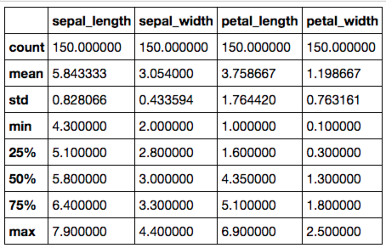
Performing Statistical Calculations
Multiple calculations can be presented in a DataFrame
Code
Output
print(data.describe())
>>>
Notes:
With all these statistical functions, code can get messy if you wanted to call all of them one by one.
Instead, pandas DFs has a nice .describe method which will summarize the info contained in the dataframe.

Slide 90
Performing Statistical Calculations
Multiple calculations can be presented in a DataFrame
Code
Output
print(data.describe())
>>>
Notes:
Here it is, with one call, we’re able to see the count (size), mean, std, min, max and quantiles.
Notice that it dropped the non-numeric fields automatically.

Slide 91
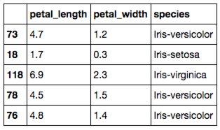
Sampling from DataFrames
DataFrames can be randomly sampled from
Code
Output
# Sample 5 rows without replacement
sample = (data
.sample(n=5,
replace=False,
random_state=42))
print(sample.iloc[:,-3:])
>>>
Notes:
So far we looked at the first 5 rows, but there is a convenient way in pandas to sample randomly too.
.sample will let us sample randomly.

Slide 92
Sampling from DataFrames
DataFrames can be randomly sampled from
Code
Output
# Sample 5 rows without replacement
sample = (data
.sample(n=5,
replace=False,
random_state=42))
print(sample.iloc[:,-3:])
>>>
Notes:
Here are 5 samples drawn from the original DataFrame, without replacements.
Random_state is a keyword argument, if specified, essentially random sampling becomes deterministic, so that if the audience does this as well, they get the same result.

Slide 93
Sampling from DataFrames
DataFrames can be randomly sampled from
Code
Output
# Sample 5 rows without replacement
sample = (data
.sample(n=5,
replace=False,
random_state=42))
print(sample.iloc[:,-3:])
>>>
SciPy and NumPy also contain a variety of statistical functions.
Notes:
It’s worth noting that there is a world of statistical functions outside pandas offers, and scipy and numpy are great libraries for them. You can use them along with dataframes’ .apply and get the result.

Slide 94
Visualization Libraries
Visualizations can be created in multiple ways:
Matplotlib
Pandas (via Matplotlib)
Seaborn
Statistically-focused plotting methods
Global preferences incorporated by Matplotlib
Notes:
Finally let’s talk briefly about data visualization.
Matplotlib is the main library to create plots and graphs. It has a lot of features and tweaks. Definitely very useful.
Pandas offer convenient wrapper functions around matplotlib’s apis, so plots can be created easily on the fly. It’s very convenient, however, it’s less powerful compared to matplotlib. Often it’s good enough.
Seaborn is a library built on top of matplotlib, and it creates very pretty plots. It has shorthand methods to create statistically interesting plots such as linear model plots, pairwise correlation plts etc which would take a long time with matplotlib. Also, once imported, seaborn’s preferences are incorporated by matplotlib, so if you import seaborn and use matplotlib, it would look like you used seaborn, which is a good thing as we will see in a minute.

Slide 95
Basic Scatter Plots with Matplotlib
Scatter plots can be created from Pandas Series
Code
Output
Import matplotlib.pyplot as plt
plt.plot(data.sepal_length, data.sepal_width,
ls ='', marker='o')
Notes:
Let’s look at the syntax quickly.
This is how one imports matplotlib.
Keep in mind that if working within a jupyter notebook, calling %matplotlib inline (once) will make it plot inside the notebook.
Here we’re plotting sepal length vs sepal width.
Ls is shorthand for linestyle, and it is empty, making this a scatter plot (dots are not connected by lines)
Marker specifies the look of the dots

Slide 96
Basic Scatter Plots with Matplotlib
Scatter plots can be created from Pandas Series
Code
Output
Import matplotlib.pyplot as plt
plt.plot(data.sepal_length, data.sepal_width,
ls ='', marker='o')
Notes:
Here we’re plotting sepal length vs sepal width.
Ls is shorthand for linestyle, and it is empty, making this a scatter plot (dots are not connected by lines)
Marker specifies how the dots look
Let’s also note that plt.scatter would create the same plot without the need of specifying linestyle.

Slide 97
Basic Scatter Plots with Matplotlib
Multiple layers of data can also be added
Code
Output
plt.plot(data.sepal_length, data.sepal_width,
ls ='', marker='o',
label='sepal')
plt.plot(data.petal_length,
data.petal_width,
ls ='', marker='o',
label='petal')
Notes:
We can plot once, then plot again. Unless otherwise specified, it will plot on the same figure, with a. default choice of colors.
Here we’re labeling the two scatter plots.

Slide 98
Basic Scatter Plots with Matplotlib
Multiple layers of data can also be added
Code
Output
plt.plot(data.sepal_length, data.sepal_width,
ls ='', marker='o',
label='sepal')
plt.plot(data.petal_length,
data.petal_width,
ls ='', marker='o',
label='petal')
Notes:
And the first scatter plot is blue, second is green.

Slide 99
Histograms with Matplotlib
Histograms can be created from Pandas Series
Code
Output
plt.hist(data.sepal_length, bins=25)
Notes:
Plt also has this shortcut of creating histograms.
.hist with 25 bins will create an histogram

Slide 100
Histograms with Matplotlib
Histograms can be created from Pandas Series
Code
Output
plt.hist(data.sepal_length, bins=25)
Notes:
There it is. It divides the range specified by the min and max into 25 bins and counts the records in each bin.

Slide 101
Customizing Matplotlib Plots
Every feature of Matplotlib plots can be customized
Code
Output
fig, ax = plt.subplots()
ax.barh(np.arange(10),
data.sepal_width.iloc[:10])
# Set position of ticks and tick labels
ax.set_yticks(np.arange(0.4,10.4,1.0))
ax.set_yticklabels(np.arange(1,11))
ax.set(xlabel='xlabel', ylabel='ylabel',
title='Title')
Notes:
One can use matplotlib with plt.plot or like this:
Fig, is a figure and ax is the axis in the figure. There can be many axes in one figure.
This way is perhaps more detailed, but more customizable.
We’re plotting a horizontal bargraph here (with ax.barh)
We’re setting the y ticks, yticklabels,
X and ylabels and the title.

Slide 102
Customizing Matplotlib Plots
Every feature of Matplotlib plots can be customized
Code
Output
fig, ax = plt.subplots()
ax.barh(np.arange(10),
data.sepal_width.iloc[:10])
# Set position of ticks and tick labels
ax.set_yticks(np.arange(0.4,10.4,1.0))
ax.set_yticklabels(np.arange(1,11))
ax.set(xlabel='xlabel', ylabel='ylabel',
title='Title')
Notes:
And the result looks like this.

Slide 103
Incorporating Statistical Calculations
Statistical calculations can be included with Pandas methods
Code
Output
(data
.groupby('species')
.mean()
.plot(color=['red','blue',
'black','green'],
fontsize=10.0, figsize=(4,4)))
Notes:
Let’s now see an example of plotting with pandas, without invoking matplotlib.
Here, we’re groupnig by, and getting the mean values of the groups.
We specify the fontsize and the figure size and colors (also possible with matplotlib)

Slide 104
Incorporating Statistical Calculations
Statistical calculations can be included with Pandas methods
Code
Output
(data
.groupby('species')
.mean()
.plot(color=['red','blue',
'black','green'],
fontsize=10.0, figsize=(4,4)))
Notes:
And the result looks like this.
Note that you still have to call %matplotlib inline within a notebook.

Slide 105
Statistical Plotting with Seaborn
Joint distribution and scatter plots can be created
Code
Output
import seaborn as sns
sns.jointplot(x='sepal_length',
y='sepal_width',
data=data, size=4)
Notes:
Finally, let’s see how seaborn works.
This is the standard way to import seaborn
Jointplot is a shorthand seaborn method which will create histograms for both x and y and a scatter plot

Slide 106
Statistical Plotting with Seaborn
Joint distribution and scatter plots can be created
Code
Output
import seaborn as sns
sns.jointplot(x='sepal_length',
y='sepal_width',
data=data, size=4)
Notes:
Super convenient and pretty.
Notice the correlation analysis performed as well.

Slide 107
Statistical Plotting with Seaborn
Correlation plots of all variable pairs can also be made with Seaborn
Code
Output
sns.pairplot(data, hue='species', size=3)
Notes:
Another useful feature of seaborn is the pairplot.
This looks at the pairwise comparison of the columns in a given dataframe.

Slide 108
Statistical Plotting with Seaborn
Correlation plots of all variable pairs can also be made with Seaborn
Code
Output
sns.pairplot(data, hue='species', size=3)
Notes:
Focus on the diagonal, it’s the histograms of the features.
And the off-diagonal plots are scatter plots.
Note that it’s color coded by “species” as specified in the function call.
It’s very useful for data exploration.

